Slide 1
Final Project
House Price Prediction Kaggle competition (83% acc)
Name: Peter Ashraf
Group : Online CDSP 25/6
Supervision: Eng. / Islam Jekso & Eng. / Mohamed El Behery

Slide 2
Points
Description of Data
Info Of Data
Missing Representation
Feature Engineering
Pd.get_dummies
Model and model exportation using joblib
Import model and use Flask, Postman and Heroku for deployment

Slide 3
What this Project is ALL about? And What About Steps?
From Its name is all about Prediction house Price Depending on some features
Steps:-
Data Exploration and Analysis
Visualization, missing percentage, answering Questions about features relations
Data Preprocess and Feature Engineering
Like Creating new columns/Features (year diff) and percentage of finished areas
Dealing with outliers
Getting Dummies
Converting Categorical Data into numerical data
Machine Learning Process and model deployment and putting it online using Flask

Slide 4
NOTES:-
We Didn’t use Feature Selection and PCA as our model generate Very good accuracy 83% on testing step
First we will start with visualization in this presentation and we will explain each one and we will see if the x and y axis have regression relationship or not.

Slide 5
count mean std min 25% 50% 75% max
Id 1460.0 730.500000 421.610009 1.0 365.75 730.5 1095.25 1460.0
MSSubClass 1460.0 56.897260 42.300571 20.0 20.00 50.0 70.00 190.0
LotFrontage 1201.0 70.049958 24.284752 21.0 59.00 69.0 80.00 313.0
LotArea 1460.0 10516.828082 9981.264932 1300.0 7553.50 9478.5 11601.50 215245.0
OverallQual 1460.0 6.099315 1.382997 1.0 5.00 6.0 7.00 10.0
OverallCond 1460.0 5.575342 1.112799 1.0 5.00 5.0 6.00 9.0
YearBuilt 1460.0 1971.267808 30.202904 1872.0 1954.00 1973.0 2000.00 2010.0
YearRemodAdd 1460.0 1984.865753 20.645407 1950.0 1967.00 1994.0 2004.00 2010.0
MasVnrArea 1452.0 103.685262 181.066207 0.0 0.00 0.0 166.00 1600.0
BsmtFinSF1 1460.0 443.639726 456.098091 0.0 0.00 383.5 712.25 5644.0
BsmtFinSF2 1460.0 46.549315 161.319273 0.0 0.00 0.0 0.00 1474.0
BsmtUnfSF 1460.0 567.240411 441.866955 0.0 223.00 477.5 808.00 2336.0
TotalBsmtSF 1460.0 1057.429452 438.705324 0.0 795.75 991.5 1298.25 6110.0
1stFlrSF 1460.0 1162.626712 386.587738 334.0 882.00 1087.0 1391.25 4692.0
2ndFlrSF 1460.0 346.992466 436.528436 0.0 0.00 0.0 728.00 2065.0
LowQualFinSF 1460.0 5.844521 48.623081 0.0 0.00 0.0 0.00 572.0
GrLivArea 1460.0 1515.463699 525.480383 334.0 1129.50 1464.0 1776.75 5642.0
BsmtFullBath 1460.0 0.425342 0.518911 0.0 0.00 0.0 1.00 3.0
BsmtHalfBath 1460.0 0.057534 0.238753 0.0 0.00 0.0 0.00 2.0
FullBath 1460.0 1.565068 0.550916 0.0 1.00 2.0 2.00 3.0
HalfBath 1460.0 0.382877 0.502885 0.0 0.00 0.0 1.00 2.0
BedroomAbvGr 1460.0 2.866438 0.815778 0.0 2.00 3.0 3.00 8.0
KitchenAbvGr 1460.0 1.046575 0.220338 0.0 1.00 1.0 1.00 3.0
TotRmsAbvGrd 1460.0 6.517808 1.625393 2.0 5.00 6.0 7.00 14.0
Fireplaces 1460.0 0.613014 0.644666 0.0 0.00 1.0 1.00 3.0

Slide 6
count mean std min 25% 50% 75% max
GarageYrBlt 1379.0 1978.506164 24.689725 1900.0 1961.00 1980.0 2002.00 2010.0
GarageCars 1460.0 1.767123 0.747315 0.0 1.00 2.0 2.00 4.0
GarageArea 1460.0 472.980137 213.804841 0.0 334.50 480.0 576.00 1418.0
WoodDeckSF 1460.0 94.244521 125.338794 0.0 0.00 0.0 168.00 857.0
OpenPorchSF 1460.0 46.660274 66.256028 0.0 0.00 25.0 68.00 547.0
EnclosedPorch 1460.0 21.954110 61.119149 0.0 0.00 0.0 0.00 552.0
3SsnPorch 1460.0 3.409589 29.317331 0.0 0.00 0.0 0.00 508.0
ScreenPorch 1460.0 15.060959 55.757415 0.0 0.00 0.0 0.00 480.0
PoolArea 1460.0 2.758904 40.177307 0.0 0.00 0.0 0.00 738.0
MiscVal 1460.0 43.489041 496.123024 0.0 0.00 0.0 0.00 15500.0
MoSold 1460.0 6.321918 2.703626 1.0 5.00 6.0 8.00 12.0
YrSold 1460.0 2007.815753 1.328095 2006.0 2007.00 2008.0 2009.00 2010.0
SalePrice 1460.0 180921.195890 79442.502883 34900.0 129975.00 163000.0 214000.00 755000.0

Slide 7
Feature name Null Percentage
LotFrontage 17.739726
Alley 93.767123
MasVnrType 0.547945
MasVnrArea 0.547945
BsmtQual 2.534247
BsmtCond 2.534247
BsmtExposure 2.602740
BsmtFinType1 2.534247
BsmtFinType2 2.602740
Electrical 0.068493
FireplaceQu 47.260274
GarageType 5.547945
GarageYrBlt 5.547945
GarageFinish 5.547945
GarageQual 5.547945
GarageCond 5.547945
PoolQC 99.520548
Fence 80.753425
MiscFeature 96.301370

Slide 8
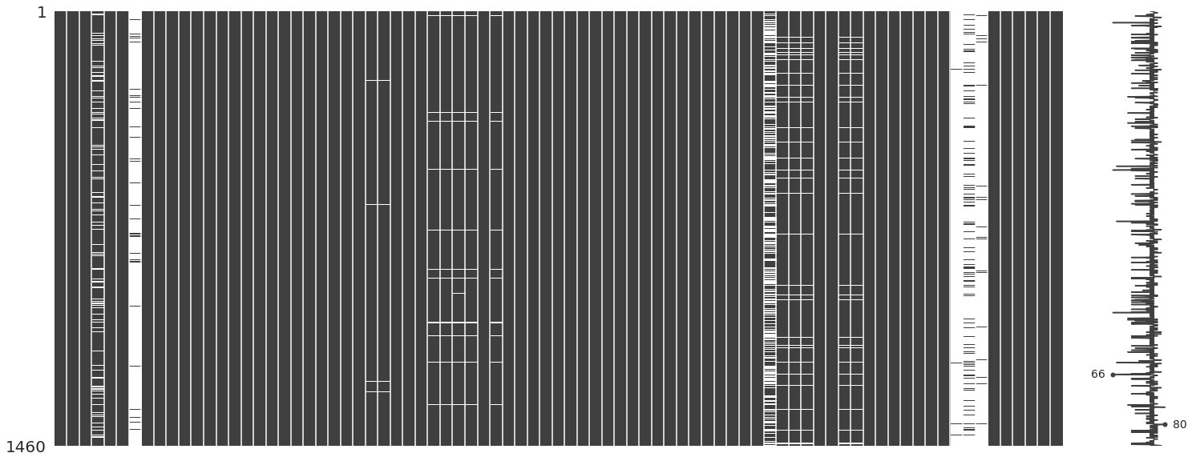
Visualizing Missing Data
We used missingno() function to represent our missing Data

Slide 9
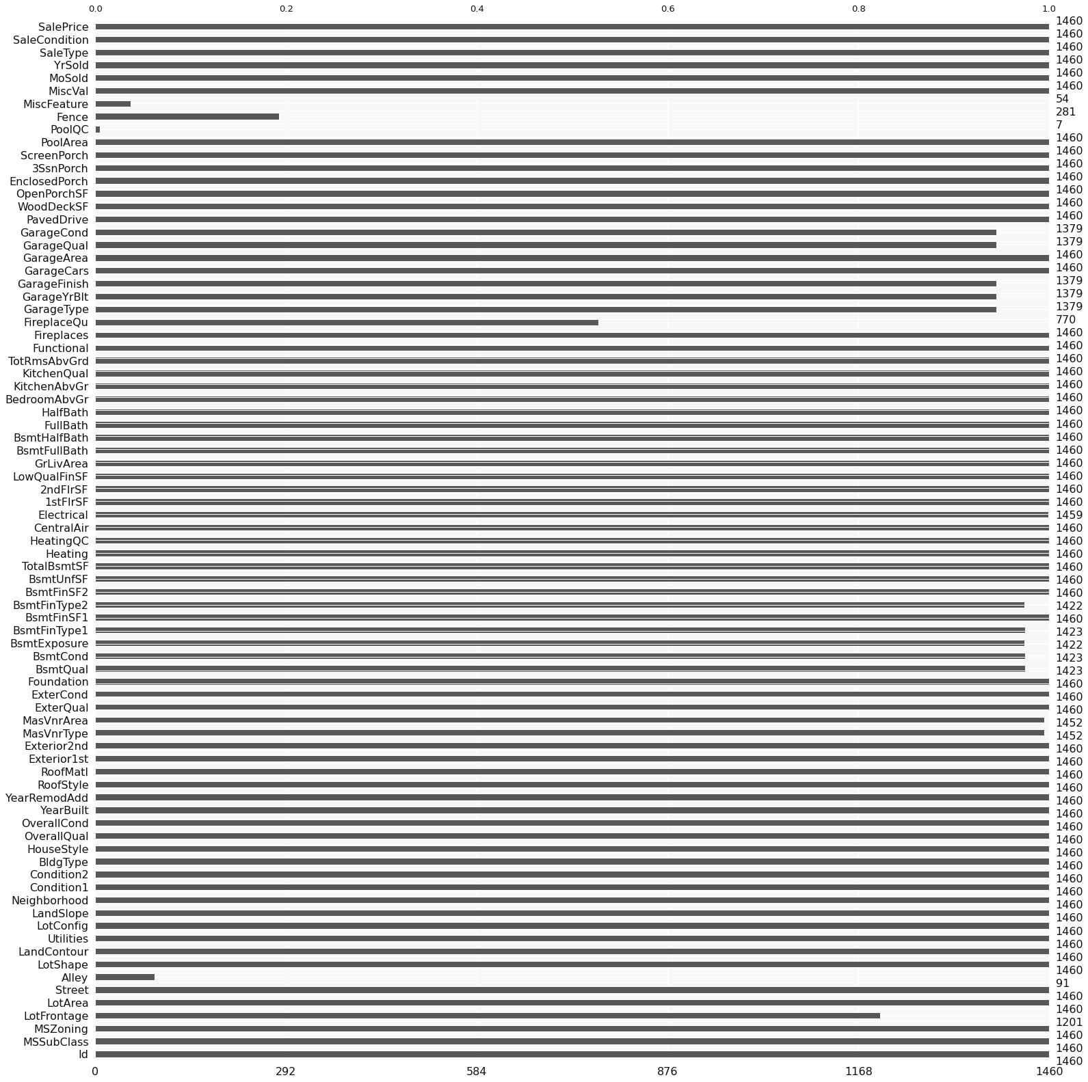
Visualizing Missing Data

Slide 10
After removing null values with more than 50% null we started to use value_counts() on categorical columns to mention how it repeated through columns
Some of columns Desribtion
MSZoning: Identifies the general zoning classification of the sale.
Street: Type of road access to property
LotShape: General shape of property
LandContour: Flatness of the property
Utilities: Type of utilities available
LandSlope: Slope of property
Neighborhood: Physical locations within Ames city limits
Condition1: Proximity to various conditions

Slide 11
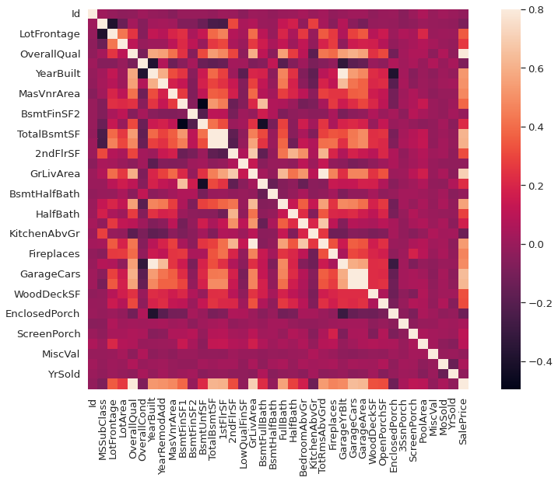
HeatMap
We use heatmap to show correlation between features

Slide 12
From now on we will answer Questions using visualizations , regplot, like do really value on x depending on y or no?
While doing this we put an eye on outliers and exclude them If needed.

Slide 13
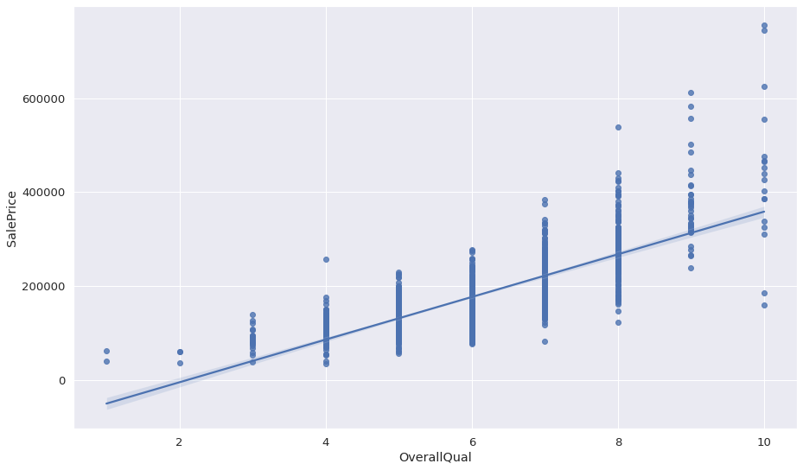
Sale Price vs overall Quality

Slide 14
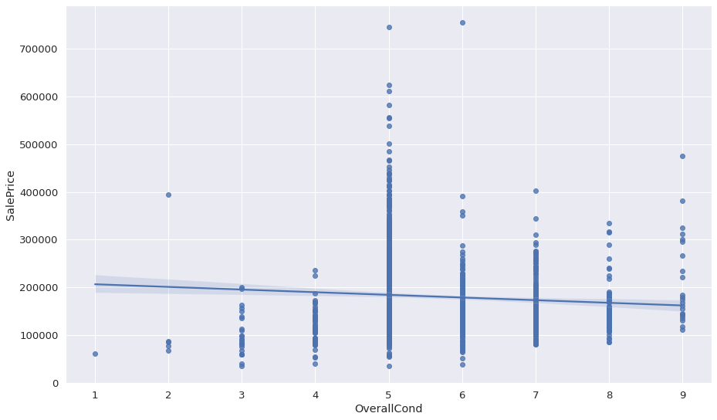
Sale Price vs overall Condition

Slide 15
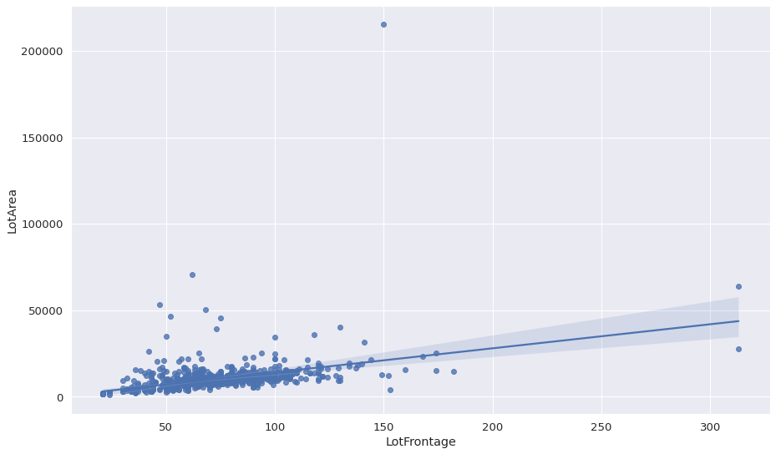
LotArea vs LotFrontage(before removing outliers)

Slide 16
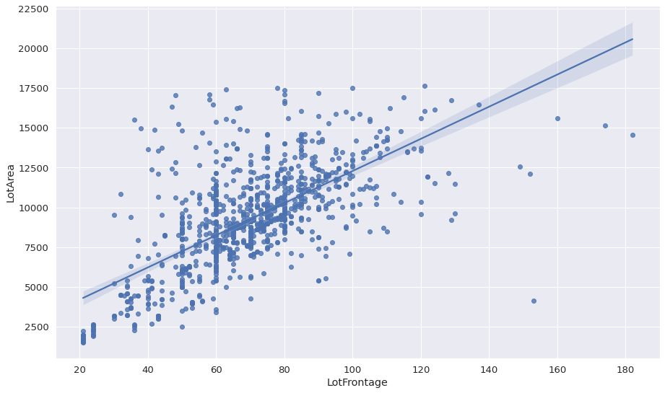
LotArea vs LotFrontage(after removing outliers)

Slide 17
Is there any changing happend through years??
YearRemodAdd - YearBuilt = if 0 = No if else = yes
Why this we want to know if there was any change or not and we will drop 2 year columns

Slide 18
1996 Year built without any modification and sold on 2007 but 745000 SalePrice
While 1920 and modified on 1950 and sold on 2009 is the minimum with 34900 SalePrice
So let's check the relation between year sold and SalePrice

Slide 19
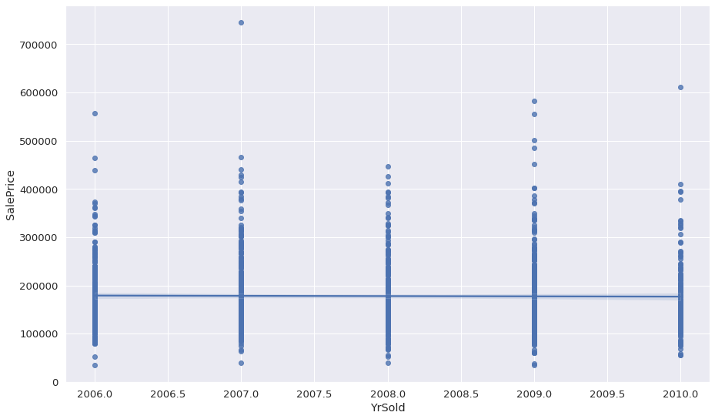
Sale price vs yearsold before removing outliers

Slide 20
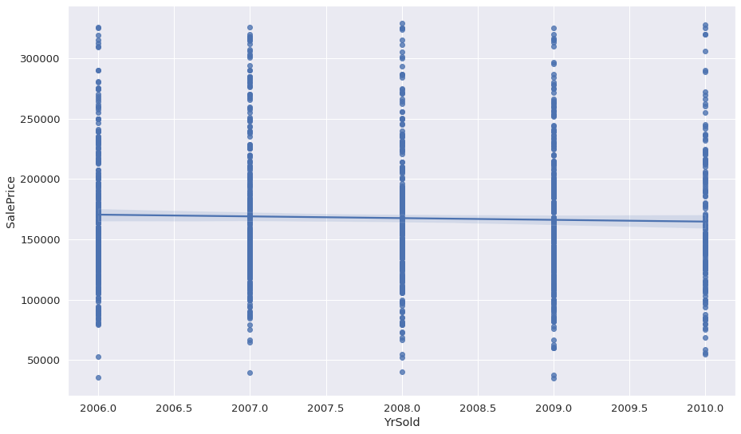
Sale price vs yearsold after removing outliers

Slide 21
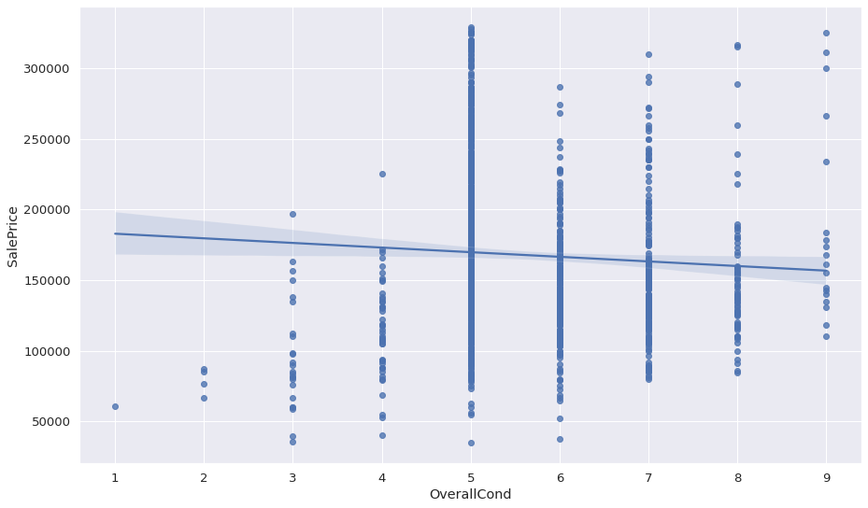
Sale price vs overall condition after removing outliers

Slide 22
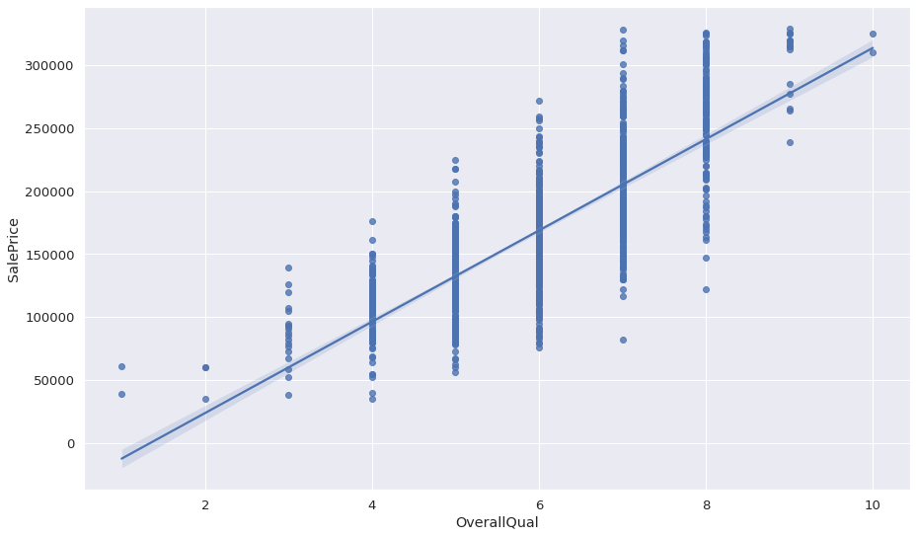
Sale price vs overall quality after removing outliers

Slide 23
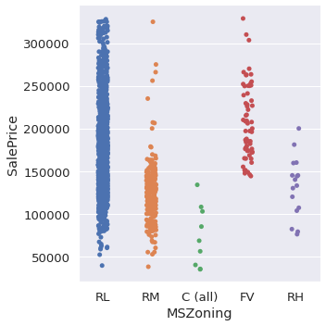
Sale price vs MsZoning after removing outliers

Slide 24
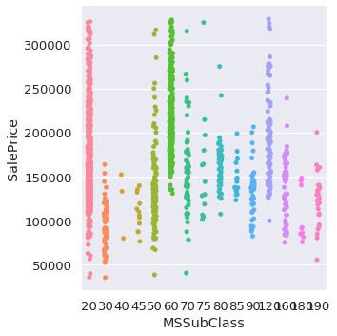
Sale price vs MsSubclass after removing outliers

Slide 25
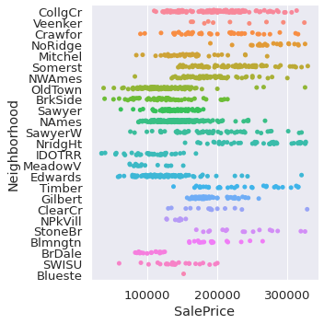
Sale price vs Neighborhood after removing outliers

Slide 26
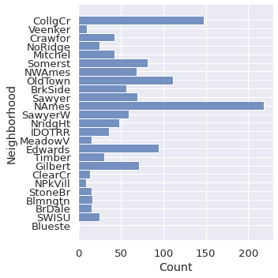
Count of neighborhood

Slide 27
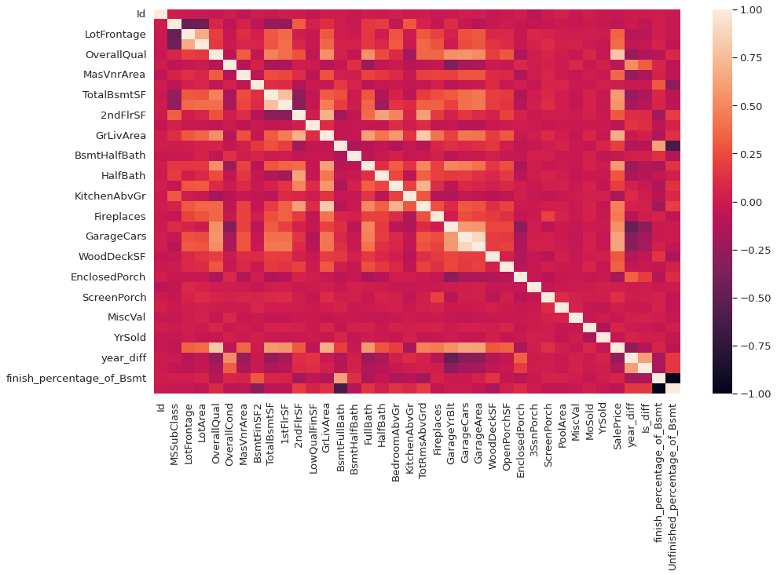
Another heatmap after removing outliers and drop columns

Slide 28
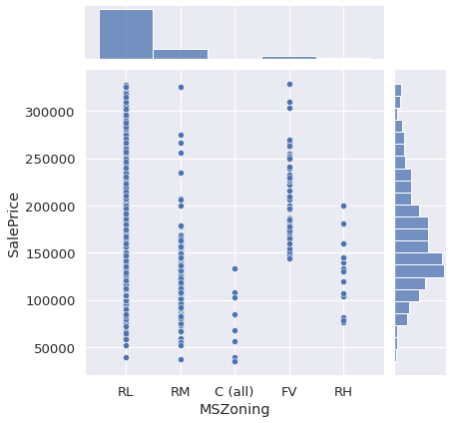
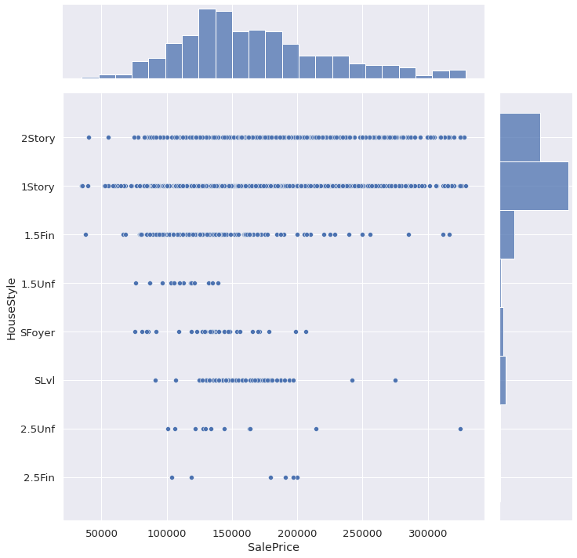
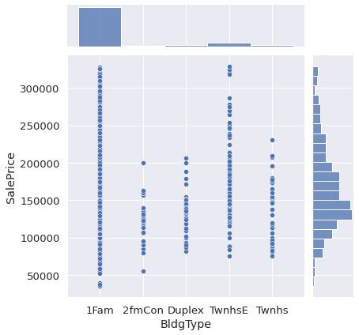
Saleprice vs housestyle, mszoning and Bldgtype

Slide 29
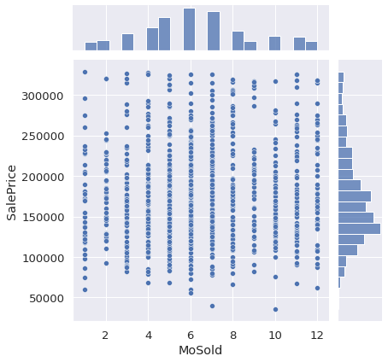
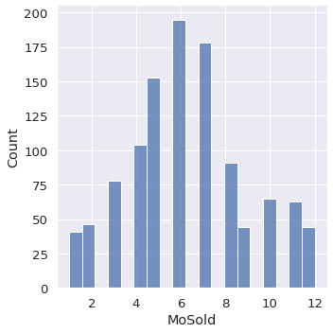
Which month Sold most and Which Year Sold most (why month 6 is the most?)

Slide 30
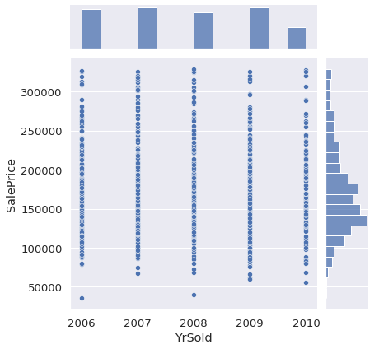
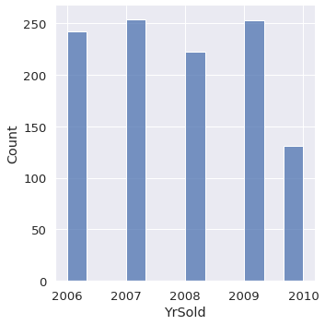
Which month Sold most and Which Year Sold most (why we have sales on 2009 after the crisis of 2008 with Us banks?)

Slide 31
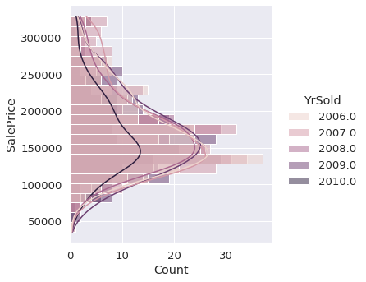
Which month Sold most and Which Year Sold most (why we have sales on 2009 after the crisis of 2008 with Us banks?) this time with much more beautiful vizualization

Slide 32
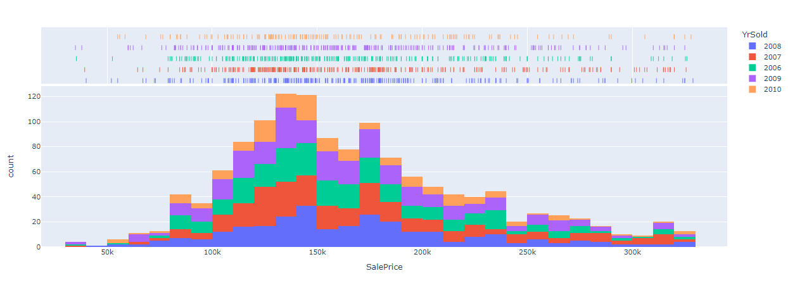
Which month Sold most and Which Year Sold most (why we have sales on 2009 after the crisis of 2008 with Us banks?) this time with much more beautiful vizualization

Slide 33
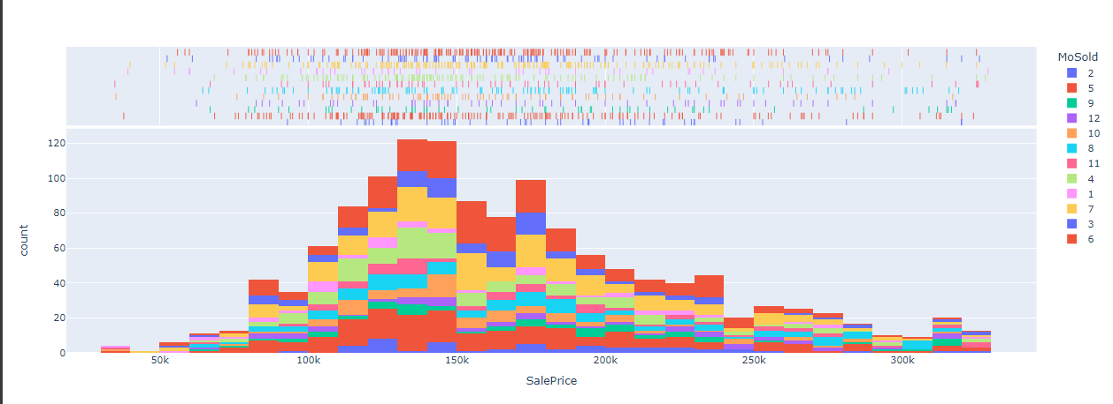
Which month Sold most and Which Year Sold most (why we have sales on 2009 after the crisis of 2008 with Us banks?) this time with much more beautiful vizualization

Slide 34
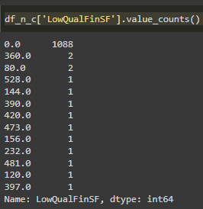
Part 2
In this part we’ve done some feature engineering like getting how much of areas are finished in the house and if that has an effect on SalePrice
We also converted categorical values into numerical and of course we re map values to have less classes for each feature like here →
From info we created a new column that shows if there any
low quality areas in the house or not if 0.
And so on for each feature.
Then we used get_dummies on columns after remaping values

Slide 35
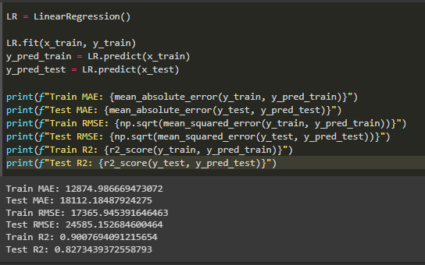
Part 3 (ML and hyper parameter tuning)
We used the loop that provided by Eng/Eslam and the perfect model was LR with 82.7 % accuracy
We also used Xgboost with nearly
same accuracy using Grid search.

Slide 36
Part 4 (Flask And Heroku)

Slide 37
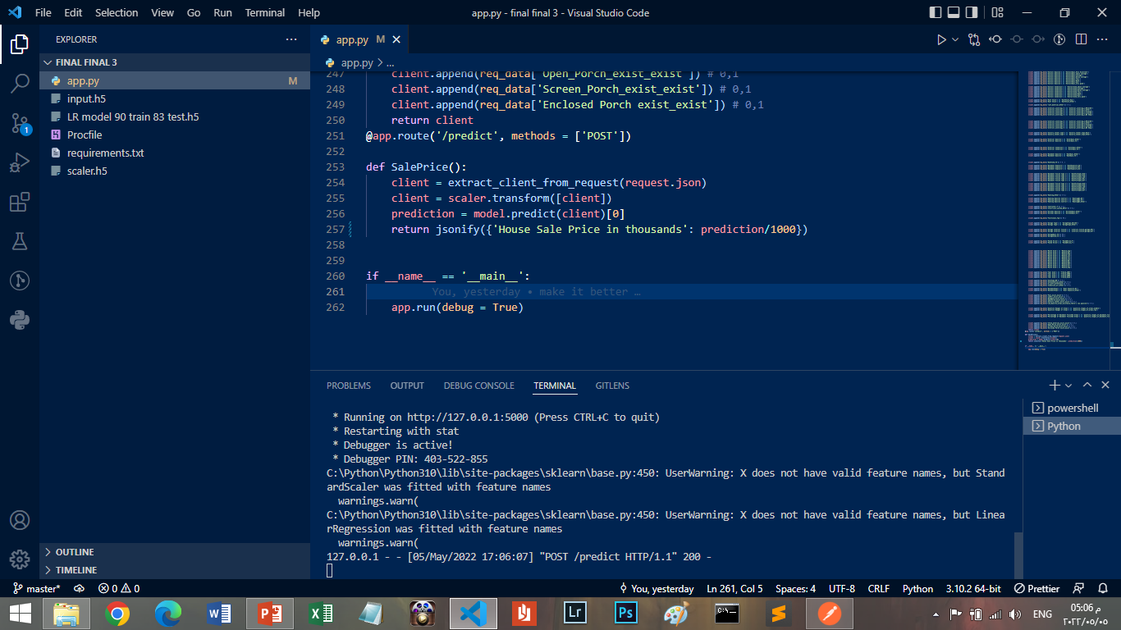
Notes:
I had some problems with this code like I forgot if __name__ thing, procfile web: gunicorn I wrote it web:guincorn

Slide 38
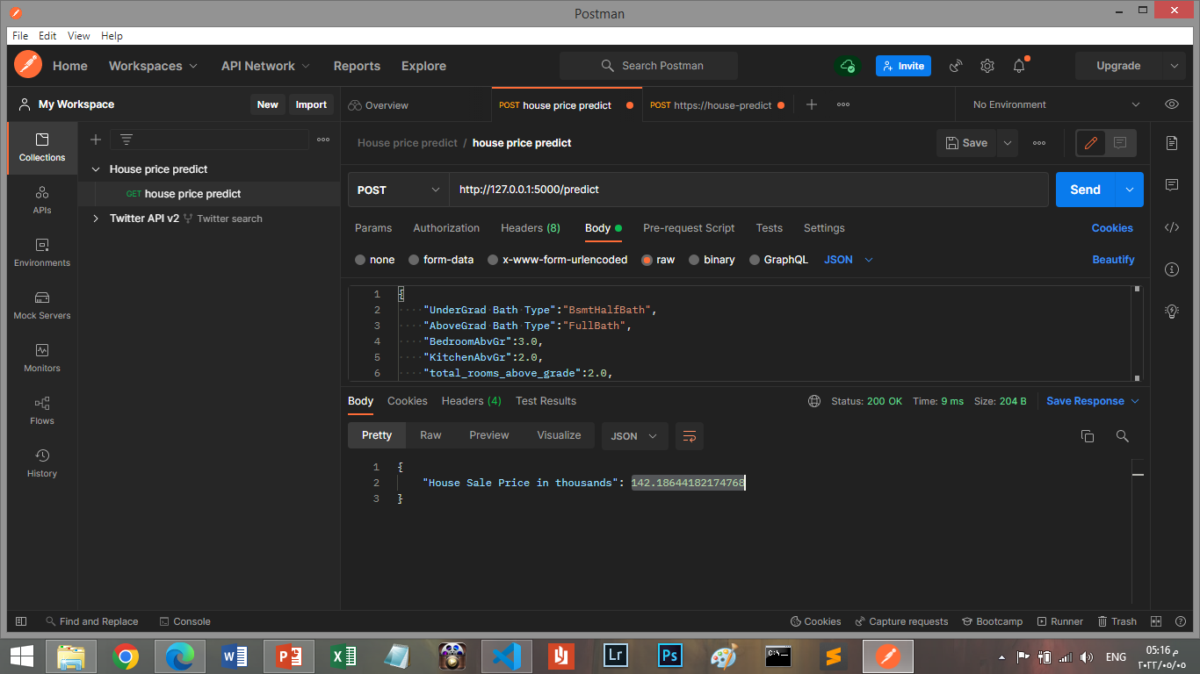
Notes:
Offline run of app I used this Json query
{
"UnderGrad Bath Type":"BsmtHalfBath",
"AboveGrad Bath Type":"FullBath",
"BedroomAbvGr":3.0,
"KitchenAbvGr":2.0,
"total_rooms_above_grade":2.0,
"Fireplaces":3.0,
"garage_car_capacity":2.0,
"other_features_values":400.0,
"year_diff":15.0,
"Dwelling Involved":"dwelling_involved_type_2-STORY 1946 & NEWER",
"General zoning classification":"general_zoning_classification_RL",
"type_of_road_Pave":1,
"property_general_shape":"property_general_shape_reg",
"property_Flatness_Other":0,
"utilities_types_NoSewa":0,
"LotConfig_Other":1,
"LandSlope_Other":0,
"neighborhood":"Neighborhood_Veenker",
"dwelling_type_Other": 0,
"House Style":"HouseStyle_2Story",
"Overall Quality":"OverallQual_average",
"Overall Condition":"OverallCond_above average",
"Roof Style":"RoofStyle_Hip",
"roof_material_Other":0,
"exterior_covering_1":"exterior_covering_1_Wd Sdng",
"exterior_covering_2":"exterior_covering_2_Wd Sdng",
"masonry_veneer_type":"masonry_veneer_type_None",
"Exterior Quality":"ExterQual_TA",
"Exterior Condition":"ExterQual_Other",
"Basement Quality":"BsmtQual_TA",
"BsmtCond_TA":0,
"Basement Exposure":"BsmtExposure_No",
"Basement Finish Type 1":"BsmtFinType1_Rec",
"Basement Finish Type 2":"BsmtFinType2_BLQ",
"Heating_Other":0,
"Heating Quality Control":"HeatingQC_TA",
"CentralAir_Y":1,
"electrical_system_SBrkr":1,
"Kitchen Quality":"KitchenQual_Other",
"Functional_Typ":1,
"Garage Type":"GarageType_Detchd",
"Garage interior finish":"interior_finish_garage_RFn",
"GarageQual_TA":0,
"GarageCond_TA":1,
"Paved Drive":"PavedDrive_N",
"Month Sold":"MoSold_Jun",
"Year Sold":"YrSold_2008",
"SaleType_WD":1,
"SaleCondition_Other":0,
"Is_diff_difference":1,
"Condition_all_Other":0,
"BasementExpo":"Bsmt Exposure_Other",
"Pool_exist_exist":0,
"2ndFlr_exist_exist":0,
"WoodDeck_exist_exist":1,
"OpenPorch_exist_exist":1,
"masonry_veneer_exist_exist":1,
"Low_Quality_areas_existance_there's low quality":0,
"Quantile Ranges of Areas":"quantile_ranges_of_areas_lowest",
"Percentage of Basement Finished Areas":"quantile_ranges_of_basement_finished_areas_Hadn't_started",
"three_enteries_exist_exist":1,
"Open_Porch_exist_exist":1,
"Screen_Porch_exist_exist":1,
"Enclosed Porch exist_exist":0
}

Slide 39
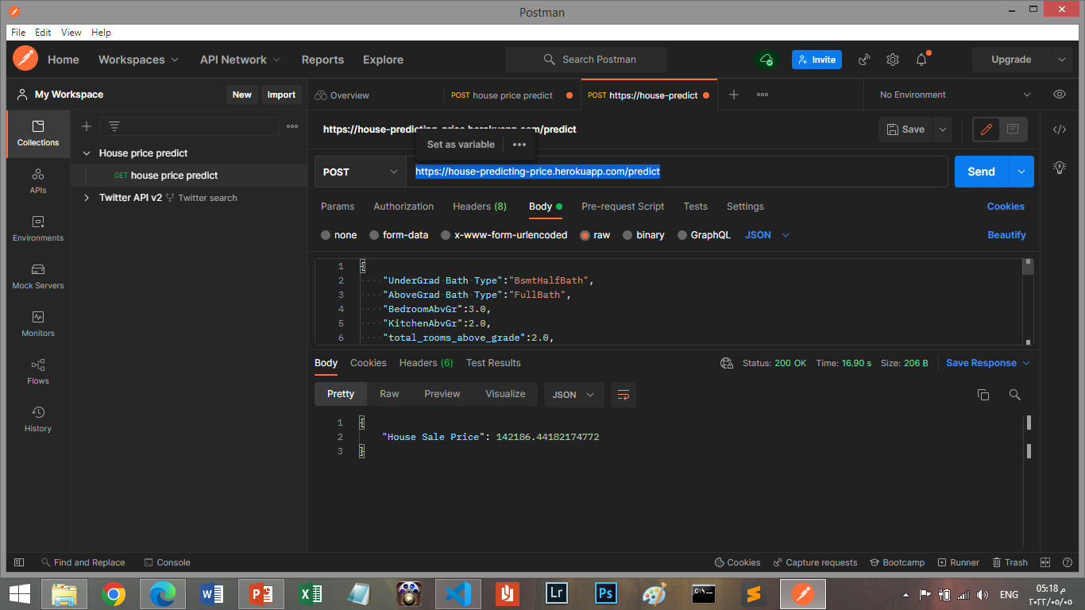
Notes:
https://house-predicting-price.herokuapp.com/predict

Slide 40
Points of improvement?
We can calculate Inflation
Feature Selection
PCA
We could use tableau or power BI to visualize the data
I started to use Html and Css to create a webapp to generate the prediction

